Slide 1


Slide 2
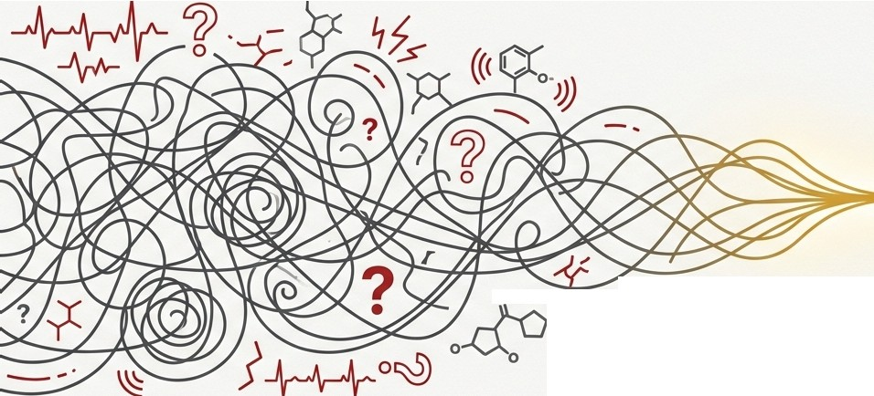
The Undifferentiated Patient: From Chaos to Clarity
A Masterclass in Emergency Medicine Decision-Making
-

Slide 3








The First Assessment: Is the Patient Sick or Not Sick?
Within moments of encounter, you must make an instantaneous assessment of the threat to the patient's life and the need for immediate intervention.
1. Primary Survey
2. The "Emergency Department Safety Net"
For any potentially sick patient, immediately initiate:
3. Findings of Potentially Serious Illness
Heart rate >120 or < 60
Respiratory rate > 20 or <10
Systolic BP < 90 mmHg
Temperature > 38°C or < 35°C
Assess Airway (A), Breathing (B), and Circulation (C).
For unresponsive adults with suspected cardiovascular emergency,usethe "CAB" approach (Circulation, Airway, Breathing) per ACLS guidelines.
Cardiac monitoring
Vascular access (IV or IO)
Hypoxia
Altered mental status
Hypoglycemia or hyperglycemia
Supplemental oxygen if needed

Slide 4
The Detective's Mindset: Assume the Worst, Rule it Out
Core Principle: Be a medical pessimist. Never assume a patient's complaint represents a benign issue until all high morbidity and mortality conditions have been considered and sufficiently excluded.
Key Concepts:
Approach each patient with a broad differential diagnosis, with the most serious possibilities at the top.
Consider lethal diagnoses even when they seem less likely than rejecting them outright because of the patient's age or an atypical presentation.
The Classic Example:
A pregnant young woman with abdominal pain. The top of your differential must always be ectopic pregnancy.

Slide 5


Slide 6
“You are working in the emergency department when a 46-year-old male arrives with epigastric pain. Their vital signs are HR 87, RR 16, BP 168/90, T 98.3, O2Sat 96%. They describe the symptoms as sharp. What’s running through your mind?”

Slide 7
When faced with a patient presenting with epigastric pain, we must consider both common and life-threatening conditions. Let’s go through some key differentials.
  Common causes.
  Serious/life-threatening causes (red flags, when to suspect them).
Before moving on, take a moment to think—what would be your top 3 differentials?

Slide 8
Now, let’s refine our differential diagnosis by looking at key history and exam findings.
  History Pearls: What to ask, red flag symptoms.
  Physical Exam Findings: What to look for.
  Diagnostic Tests: Labs, imaging, decision rules (e.g., Wells Score, HEART Score).

Slide 9
The EM Approach to Undifferentiated Patients
Sick vs Not Sick
ABCs first
Worst-first differential
Frequent reassessment
Disposition thinking early
Notes:
Expanded academic discussion on The EM Approach to Undifferentiated Patients. Include clinical examples and management sequencing.

Slide 10
What could kill them?
What do you do in first 5 minutes?
What test confirms?
What would kill them if you missed it?

